Slide 1

Food Adulteration Analysis Report
Jessica Gonsalves
Manipal Institute of Technology, Manipal

Slide 2

PROBLEM STATEMENT
The prevalence of food adulteration, where harmful or misleading substances are added to food products, poses a significant threat to public health. This Power BI report analyzes a dataset on food adulteration, investigating the types of food affected, the adulterants used, detection methods, and the severity of health risks involved. This report seeks to illuminate critical areas for intervention and empower stakeholders to ensure food safety and consumer protection by uncovering trends and patterns in adulteration practices.

Slide 3
Project Description
Objective: Analyze data on food adulteration to identify trends, patterns, and areas of high risk.
Analysis Areas:
Category of food most commonly adulterated
Common adulterants used
Various Methods used to detect these adulterants
Severity of Adulteration
Various levels of health risks each food category poses
Goals:
Improve food safety regulations
Enhance enforcement practices
Increase public awareness

Slide 4

WHO ARE THE END USERS?
Food Safety Analysis: Analyze patterns of food adulteration and contamination.
Quality Control: Improve quality control processes in the food industry.
Public Health Assessment: Assess the impact of food adulteration on public health.
Regulatory Compliance: Ensure compliance with food safety regulations.
Consumers: Spreads awareness about the various adulterations thus helping consumers to choose their products wisely

Slide 5

Technology Used
Version Control:
Git: For version control and collaboration.
Dataset: Kaggle
Visualizations: Microsoft Power BI
Github Link of the Project:https://github.com/jessicaGonsalves04/VOIS_Internship/tree/main/Final%20Project

Slide 6
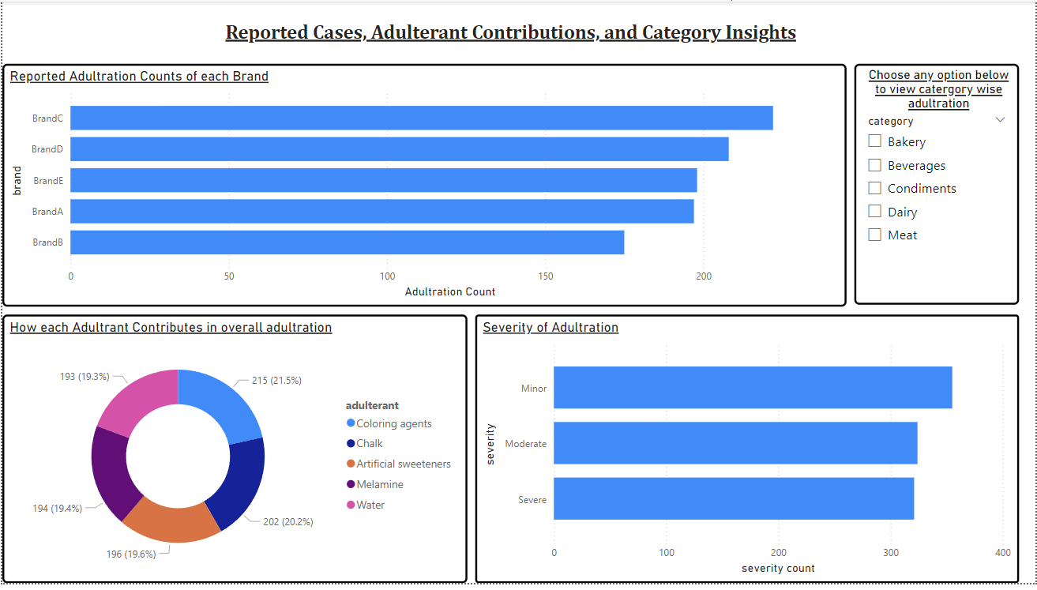
RESULTS

Slide 7
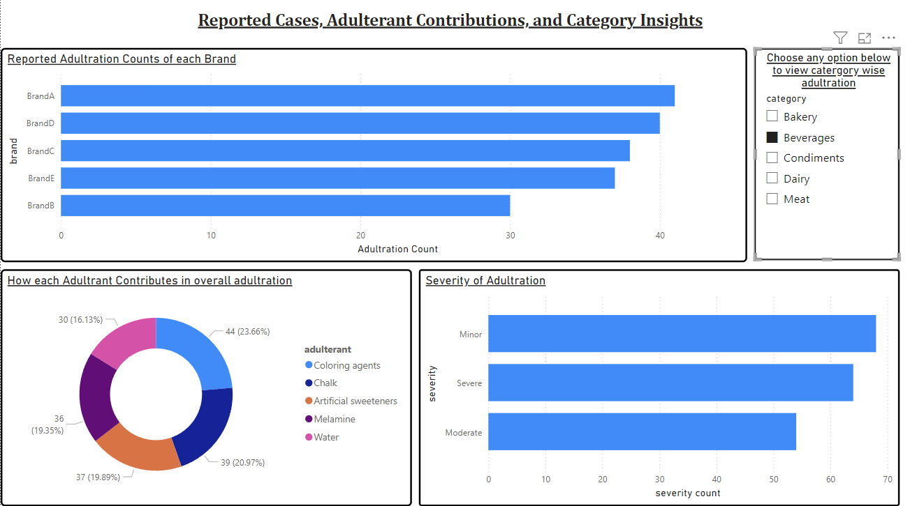

Slide 8
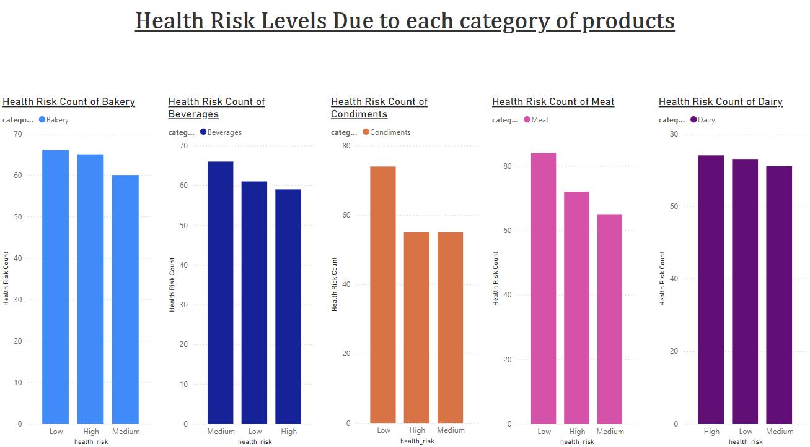

Slide 9
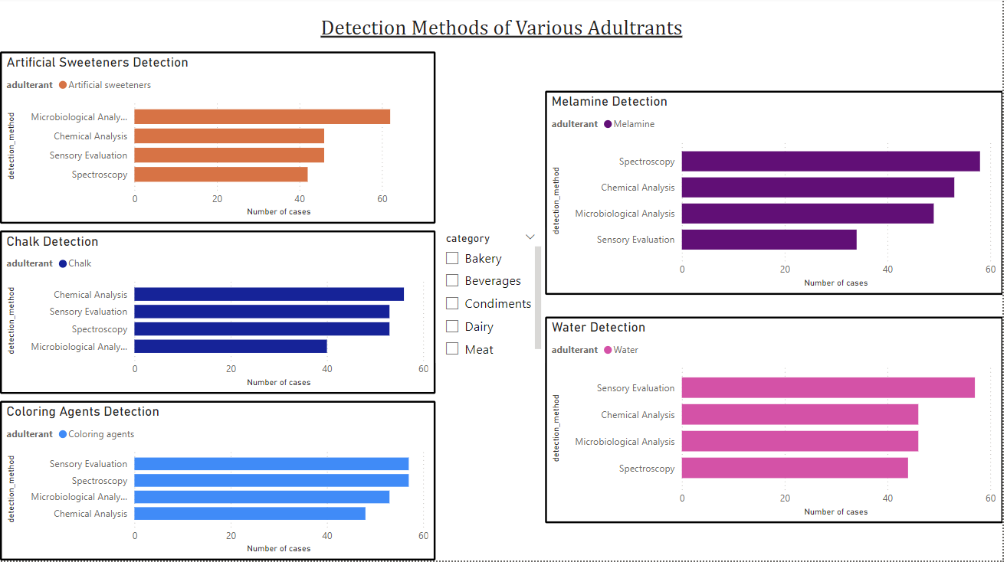

Slide 10
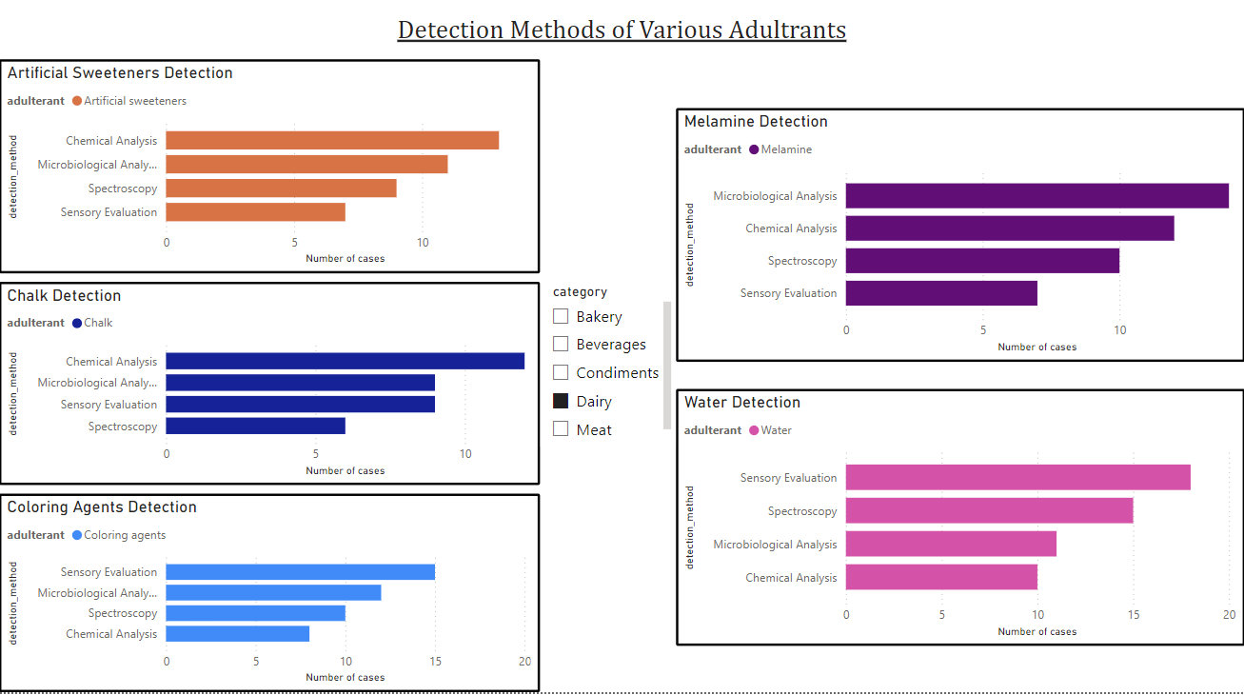

Slide 11
Thank you
.
.

